Slide 1


Pavement Assessment
March 3, 2021
Prepared by:

Slide 2
OVERVIEW
Contract for this work authorization executed 11/30/2020
This work authorization includes visual assessment of street conditions to develop priority ranking for improvements
Future work authorization will cover final engineering documents for construction contracts and may include other improvements such as drainage or traffic calming (in coordination with City staff)

Slide 3
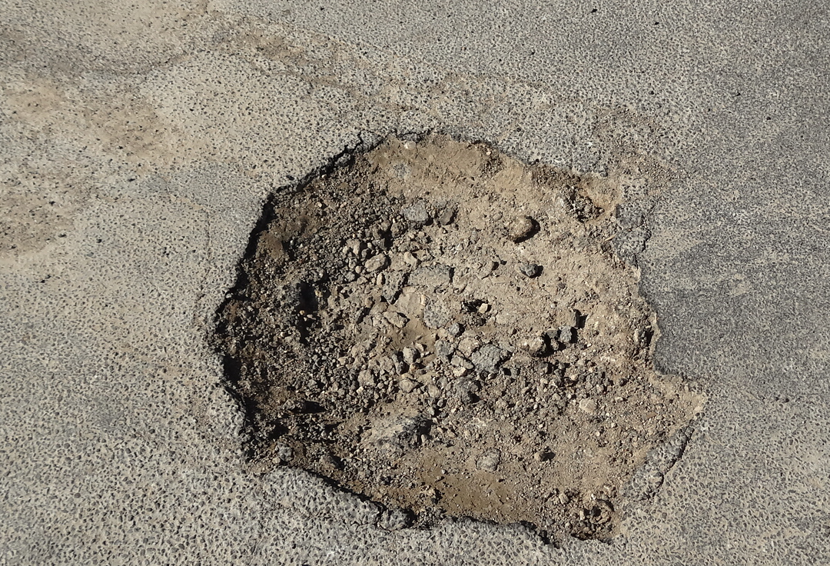
OVERVIEW
Streets were built by developers in the 1970’s/1980’s
Mostly asphalt streets with some concrete sections where drainage overtops
Per anecdote and observation, most streets were built with a thin two-course surface treatment (chip seal) over native soil (caliche)
Certain streets have been treated with subsequent chip seals over the years as maintenance projects

Slide 4
METHODOLOGY
Methodology: Based on visual observation of every City maintained street
Each segment visually observed in the field and severity of different types of pavement distress are graded as well as visual determination of ride quality
Results are plugged into a formula to compute a Pavement Condition Index (PCI) score of 0-100

Slide 5
PCI Evaluation Form
Flexible Pavement Condition Evaluation Form
Survey Date:____________________ Evaluated by:____________________
Road (Street) Name:_____________________________ Location: from ____________________ to ____________________
Section #: _____ Class of Road (circle one): freeway arterial collector local
Ride Comfort Rating (at posted speed) |  |  |  | Severity (S_{i}) |  |  |  |  | Density(D_{i})
 |  |  |  | Very Slight | Slight | Moderate | Severe | Very Severe | Few | Intermittent | Frequent | Extensive | Throughout
10 9 8 7 6 5 4 3 2 1 |  |  |  |  |  |  |  |  | <10 | 10-20 | 20-40 | 40-80 | >80
Pavement |  |  | W_{i} | 0.25 | 0.5 | 1 | 1.5 | 2 | 0.25 | 0.5 | 1 | 1.5 | 2
Surface Defects |  | Raveling & loss of surface aggregate | 1.5
 |  | Flushing | 0.5
Surface Deformations |  | Rippling and Shoving | 1
 |  | Wheel Track Rutting | 3
 |  | Distortion | 3
Cracking | Longitudinal Wheel Track | Single and Multiple | 1
 |  | Alligator | 3
 | Centerline | Single and Multiple | 0.5
 |  | Alligator | 2
 | Pavement Edge | Single and Multiple | 0.5
 |  | Alligator | 1.5
 | Transverse | Half, full and multiple | 1
 |  | Alligator | 3
 | Longitudinal - meander or mid-lane |  | 1

Slide 6
What PCI Is
Subjective observation and grading based on the opinion of the person doing the assessment
It accounts for different types of pavement distress (i.e. longitudinal cracking, alligator cracking, raveling, etc)
Different observers could do an assessment and come up with different PCI scores, but rankings should be similar
It is a snapshot in time. Streets could be reassessed in the future with different results
It is a useful, fairly inexpensive methodology for smaller cities to rank their street condition

Slide 7
What PCI Is Not
Not an objective numerical value based on results from high-tech measurement devices or other specialized instruments, which are expensive
It does not result in a “pavement design” which considers average daily traffic, heavy truck %, soil borings, subgrade condition, etc.
Repair strategies identified are general in nature, i.e. crack sealing, overlay, full-depth reconstruction

Slide 8
Assessment Results
PRIORITY PROJECTS

Slide 9
Assessment Results

Slide 10
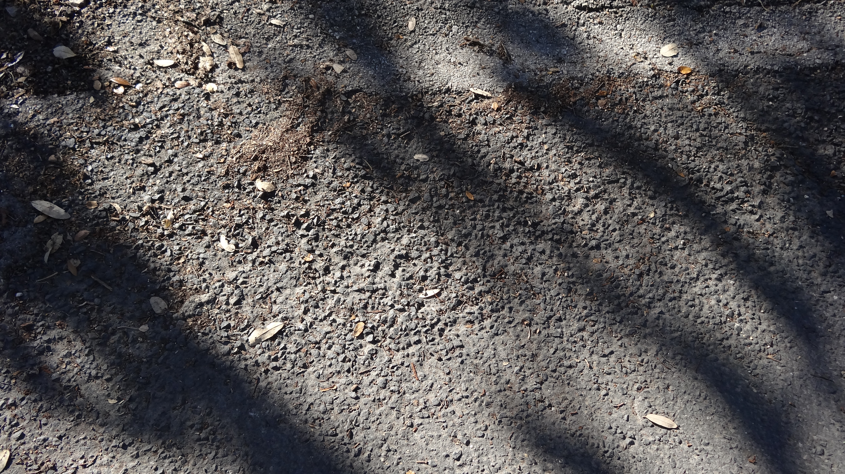
Common Distress Types
Ravelling – loss of gravel from the pavement resulting in a “pock-marked” appearance

Slide 11
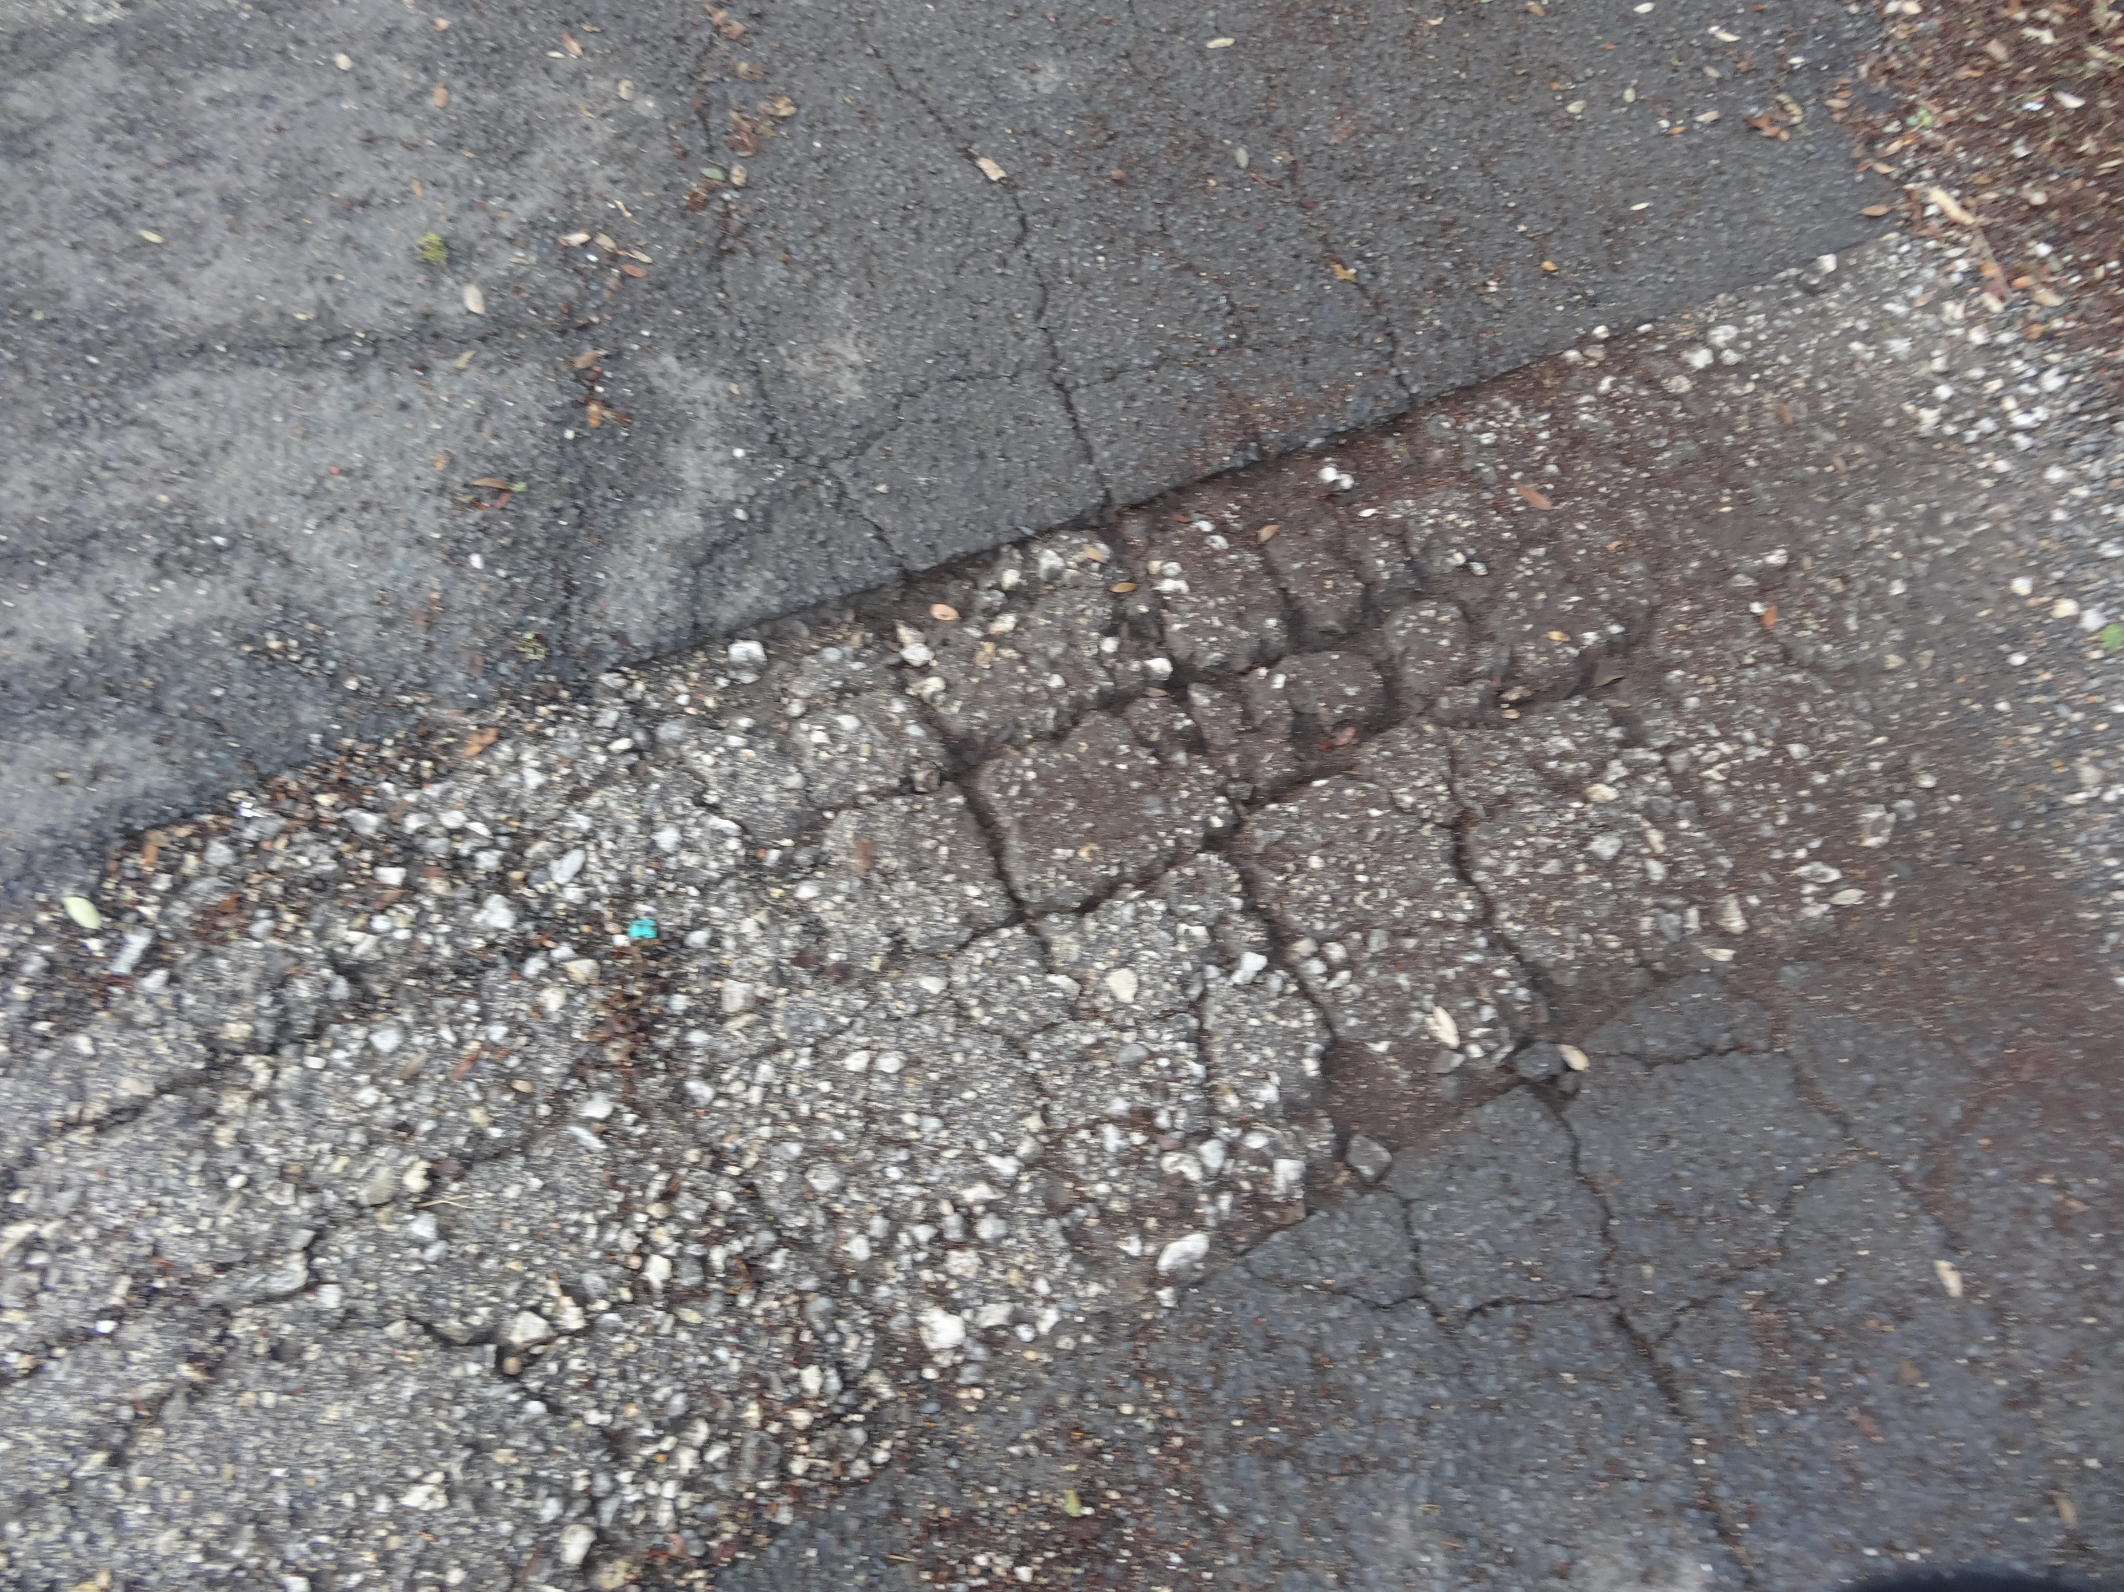
Common Distress Types
Alligator cracking – networks of cracks resembling an alligator skin

Slide 12
Common Distress Types
Potholes

Slide 13
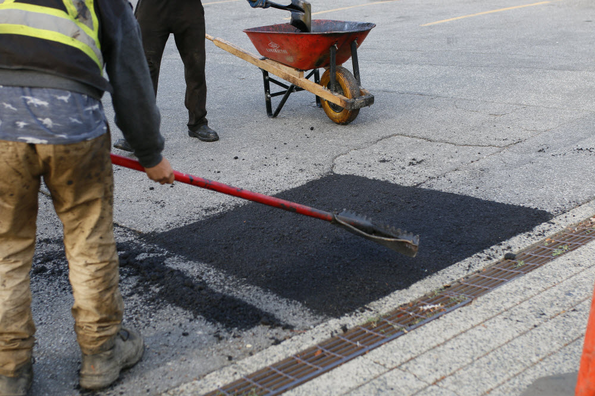
General Repair Strategies
Pothole Spot Repair
Cost - ~ $50/SY
Typ. Lifespan – indefinite depending on surface condition

Slide 14
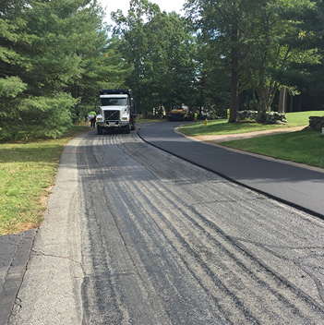
General Repair Strategies
Asphalt Overlay
Cost - ~ $25/SY
Typ. Lifespan – About 20 years with proper maintenance

Slide 15
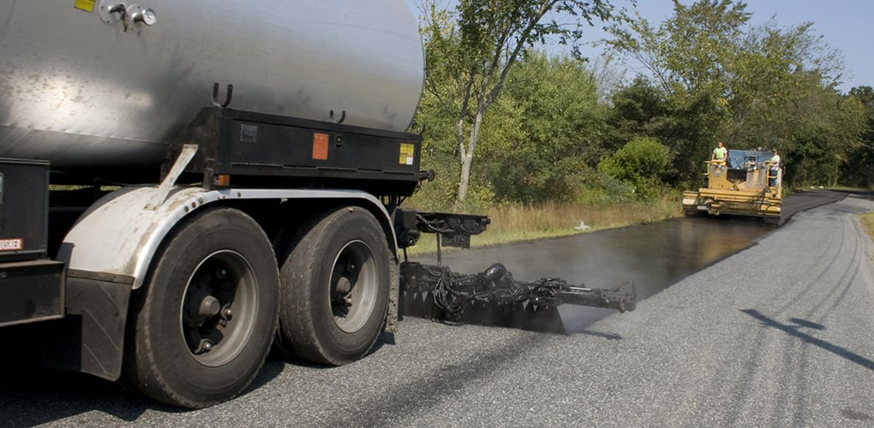
General Repair Strategies
Chip Seal (Not Considered)
Cost - ~ $5-8/SY
Typ. Lifespan – About 7 years

Slide 16
Questions
QUESTIONS?

